Slide 1

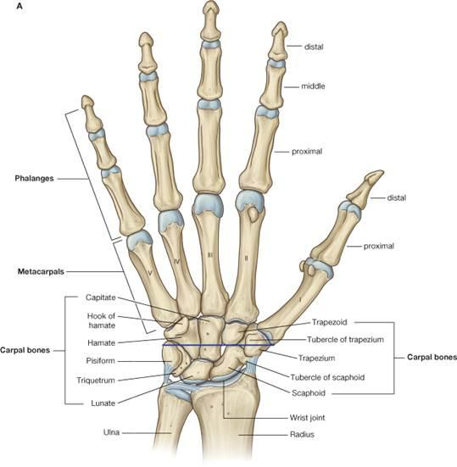
Middle Finger Proximal-Middle Phalanges Joint
Middle Finger Middle-Distal Phalanges Joint
Ring Finger Middle-
Distal Phalanges Joint
11
8
Middle Finger Metacarpal- Proximal Phalanges Joint
9
10
Ring Finger Proximal-
Middle Phalanges Joint
12
7
Index Finger Middle-Distal Phalanges Joint
6
Index Finger Proximal-Middle Phalanges Joint
Ring Finger Metacarpal-
Proximal Phalanges Joint
13
5
Index Finger Metacarpal- Proximal Phalanges Joint
4
Thumb Proximal-Distal Phalanges Joint
Pinky Finger Middle-
Distal Phalanges Joint
14
Palm
3
Thumb Metacarpal- Proximal Phalanges Joint
Pinky Finger Proximal-
Middle Phalanges Joint
15
2
Center of Paw
Pinky Finger Metacarpal-
Proximal Phalanges Joint
1
Center of Pellet
16

